Slide 1
Presentation on House Management System
Fuad Kabir
ID: 20183013010
Sadman Shafin
ID: 20183001010

Slide 2
Introduction
We have tried our best to make the complicated process of Design and Development House Management System as simple as possible using Structured & Modular technique & Menu oriented interface. The project type is :
Administrator(management of the House).

Slide 3
Existing features
“House Management System” has been designed to computerize the following functions that are performed by the system :
Add Tenter
Payment
Full History
Update Record
Delete Tenter Details

Slide 4
Software requirements
System development software
Operating system: Windows 7 and above
Development platform: NetBeans
Language: JAVA
Server: Apache
Browser: Any

Slide 5
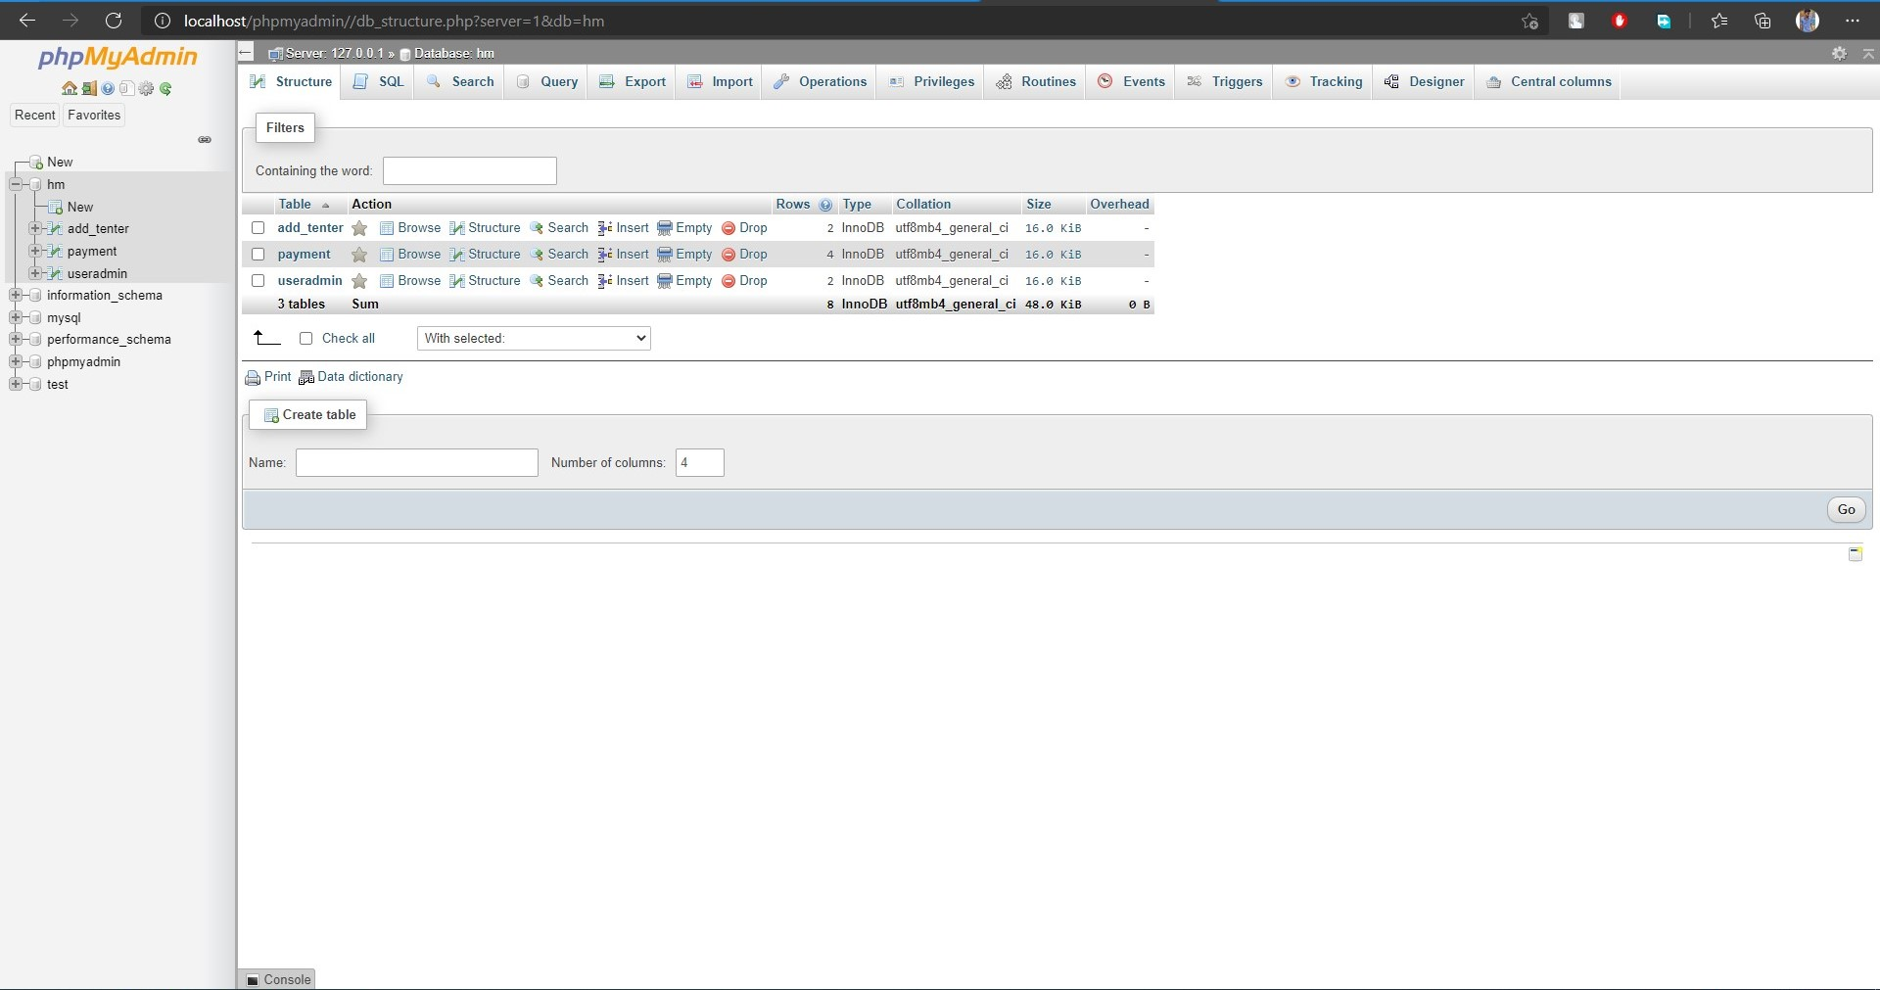
Database of House Management

Slide 6
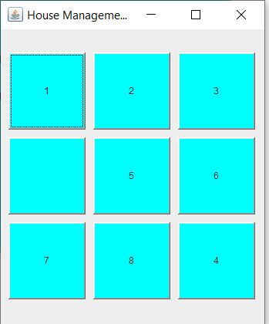
Home Page

Slide 7
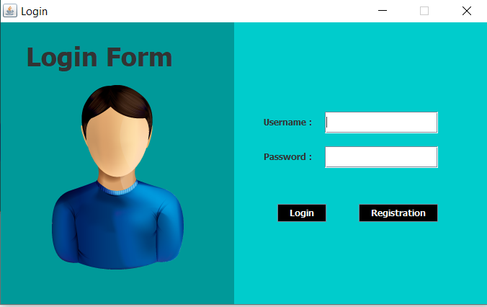
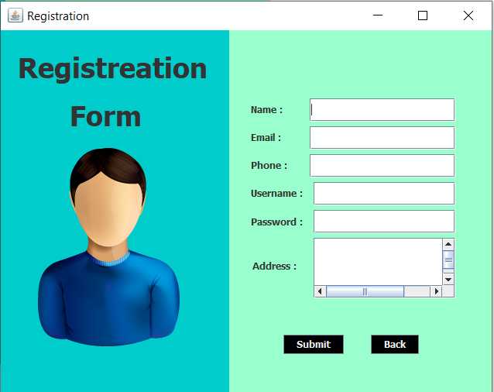
Login & Register

Slide 8
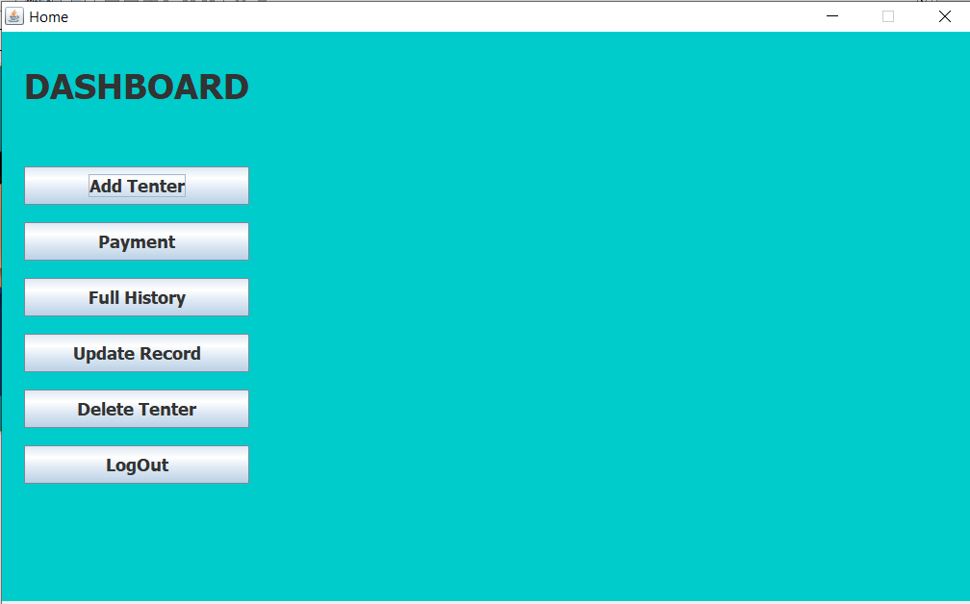
Dashboard

Slide 9
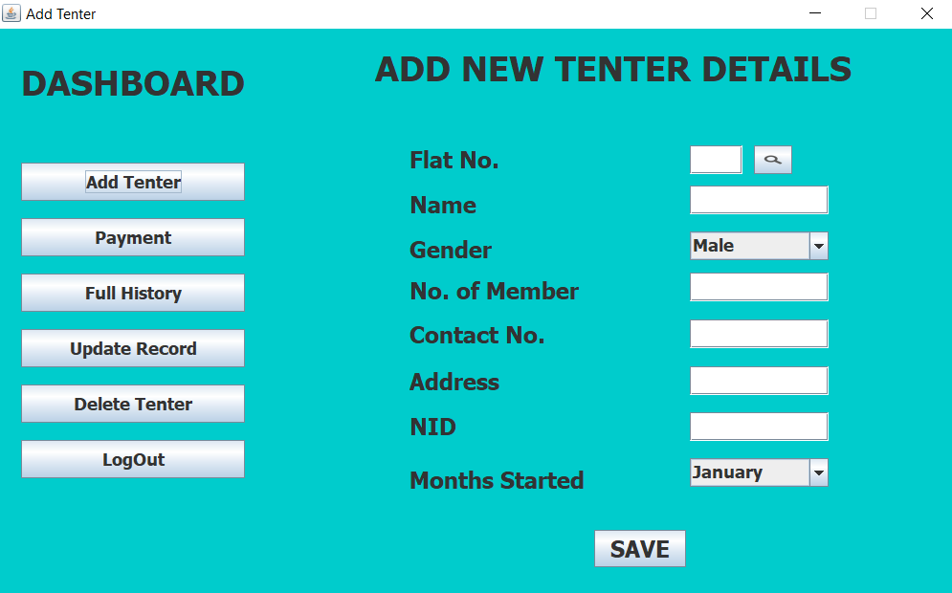
Add Tenter

Slide 10
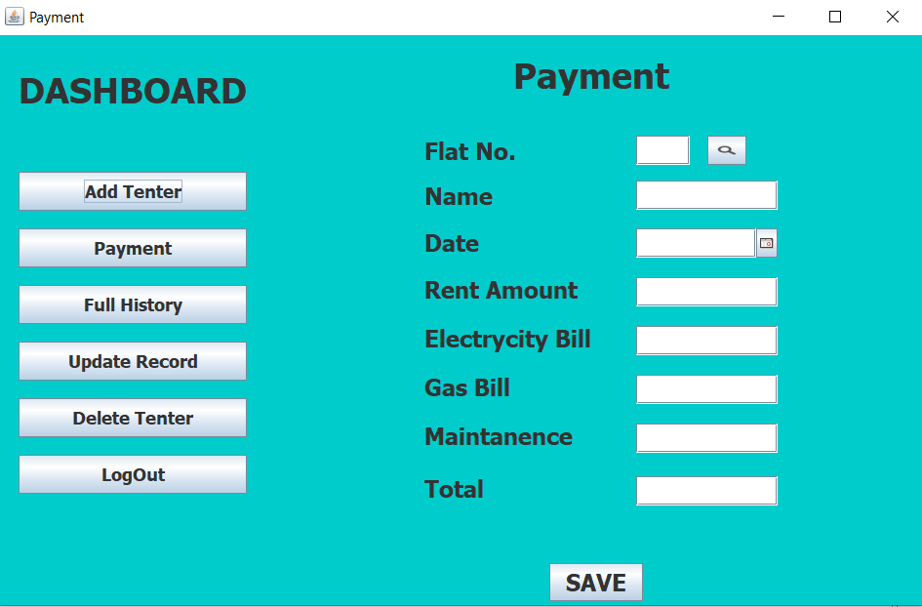
Payment

Slide 11
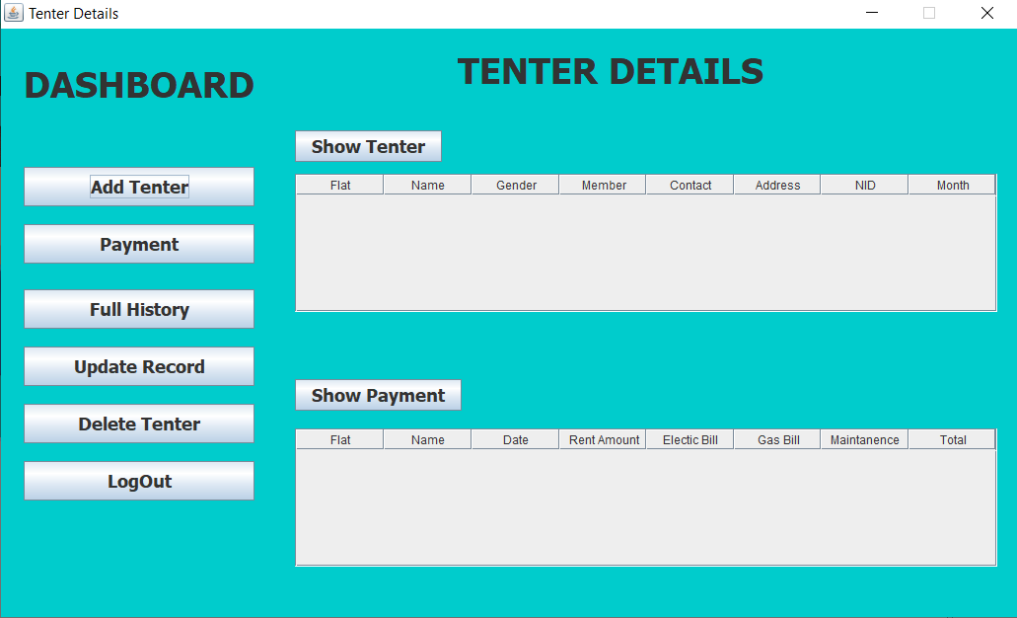
Full History

Slide 12

Update Record

Slide 13
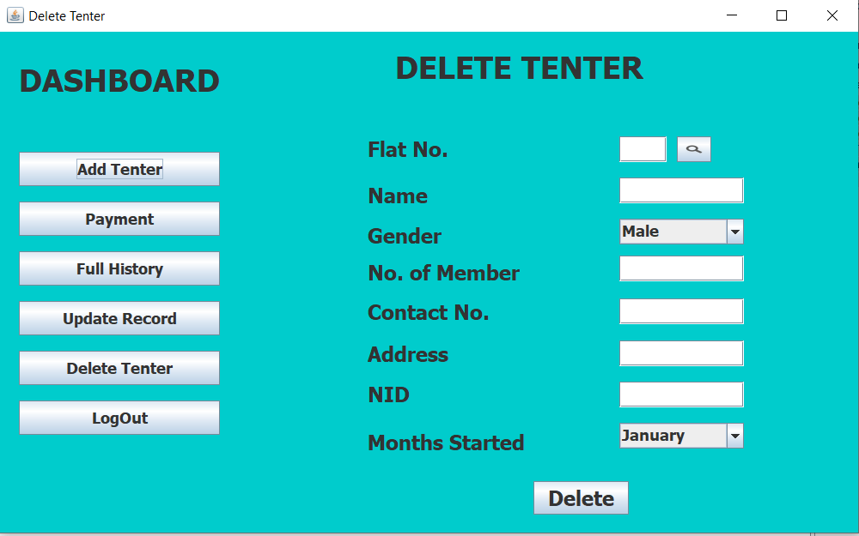
Delete Tenter

Slide 14
Future work
Change Design,
Online Visitors,
Payment Printout,
And many other thing.

Slide 15
Thank You

